Slide 1
Broadly Neutralizing SARS‑CoV‑2 Antibody
Inhalation‑based delivery and antiviral protection in non‑human primates

Slide 2
Study Background
COVID‑19 variants reduced effectiveness of many monoclonal antibodies
Systemic antibody delivery provides limited concentration in respiratory epithelium
Lung‑targeted delivery could improve antiviral protection
Researchers developed an inhalable neutralizing antibody against conserved Spike regions

Slide 3
Main Objectives
Develop a broadly neutralizing SARS‑CoV‑2 antibody
Maintain efficacy against emerging variants
Enable inhalation‑based administration
Evaluate antibody integrity after nebulization
Measure respiratory tract distribution
Assess viral load reduction in primate models

Slide 4
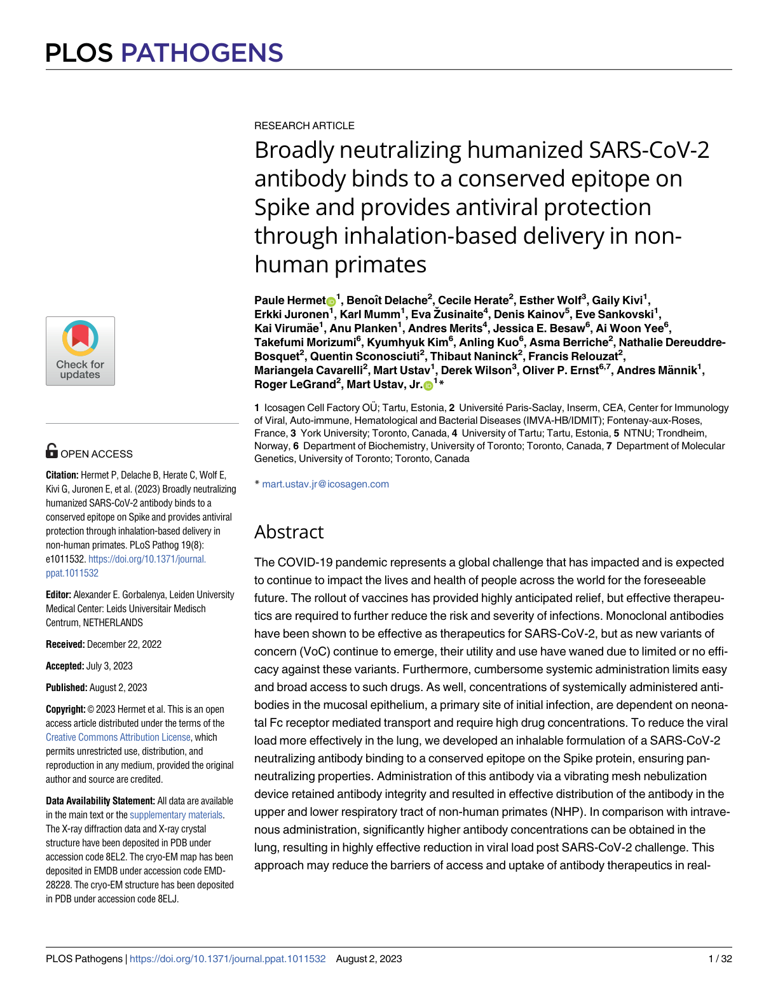
Antibody Design and Mechanism
Antibody targets a conserved Spike epitope
Designed to retain neutralization despite mutations
Nebulized delivery improves local lung exposure
Potentially lowers systemic dose requirements

Slide 5
Experimental Workflow
Antibody engineering and formulation
Nebulization testing with vibrating mesh device
Distribution analysis in respiratory tract
SARS‑CoV‑2 challenge experiments in non‑human primates
Viral load and efficacy measurements

Slide 6
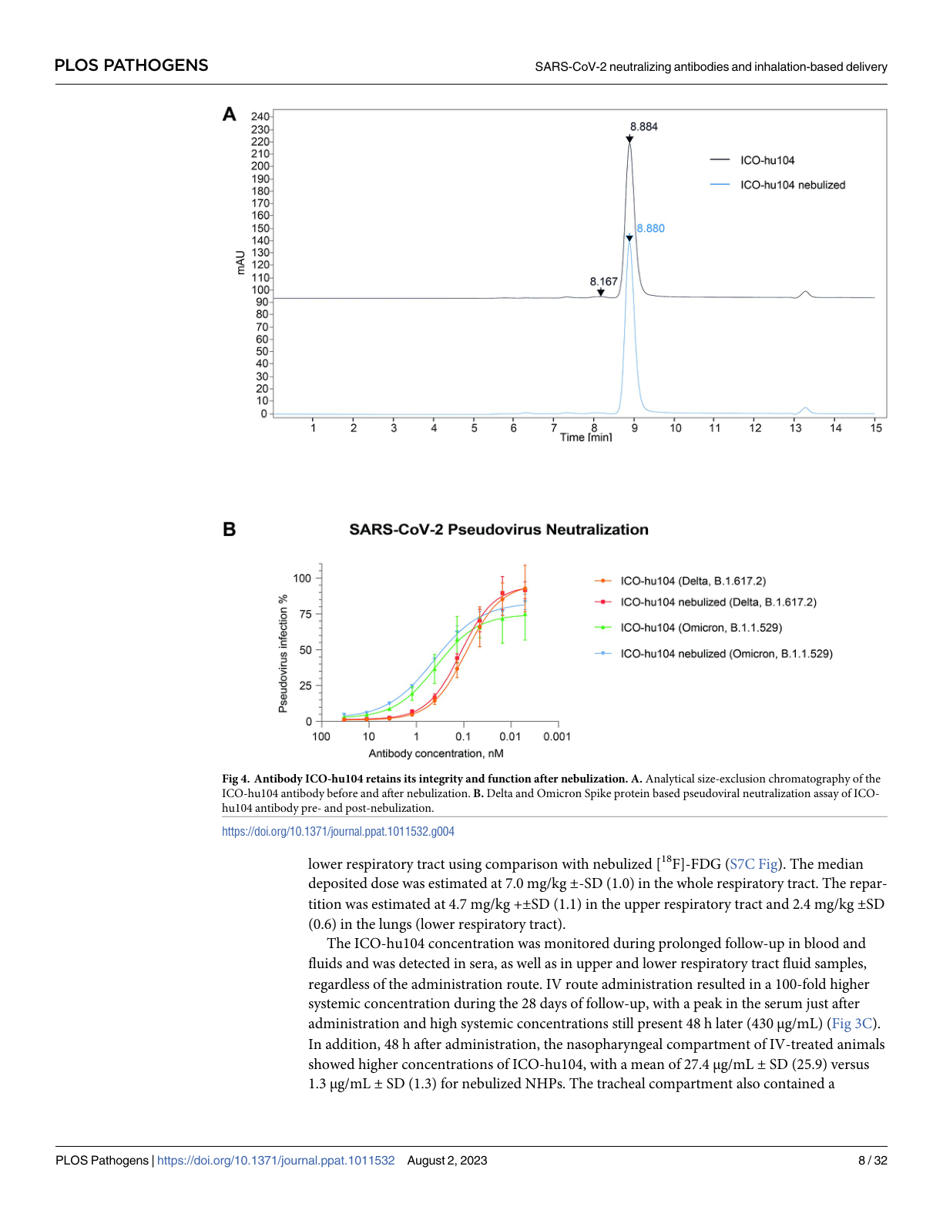
Nebulization and Lung Delivery
Nebulization preserved antibody integrity
Efficient deposition observed in upper and lower airways
Higher local antibody concentration than intravenous delivery
Supports direct respiratory therapeutic strategy

Slide 7
Key Findings
Broad neutralization across variants
Strong antiviral activity in lungs
Improved respiratory tract targeting
Reduced viral replication after challenge
Potentially reduced treatment barriers
Non‑invasive administration method

Slide 8
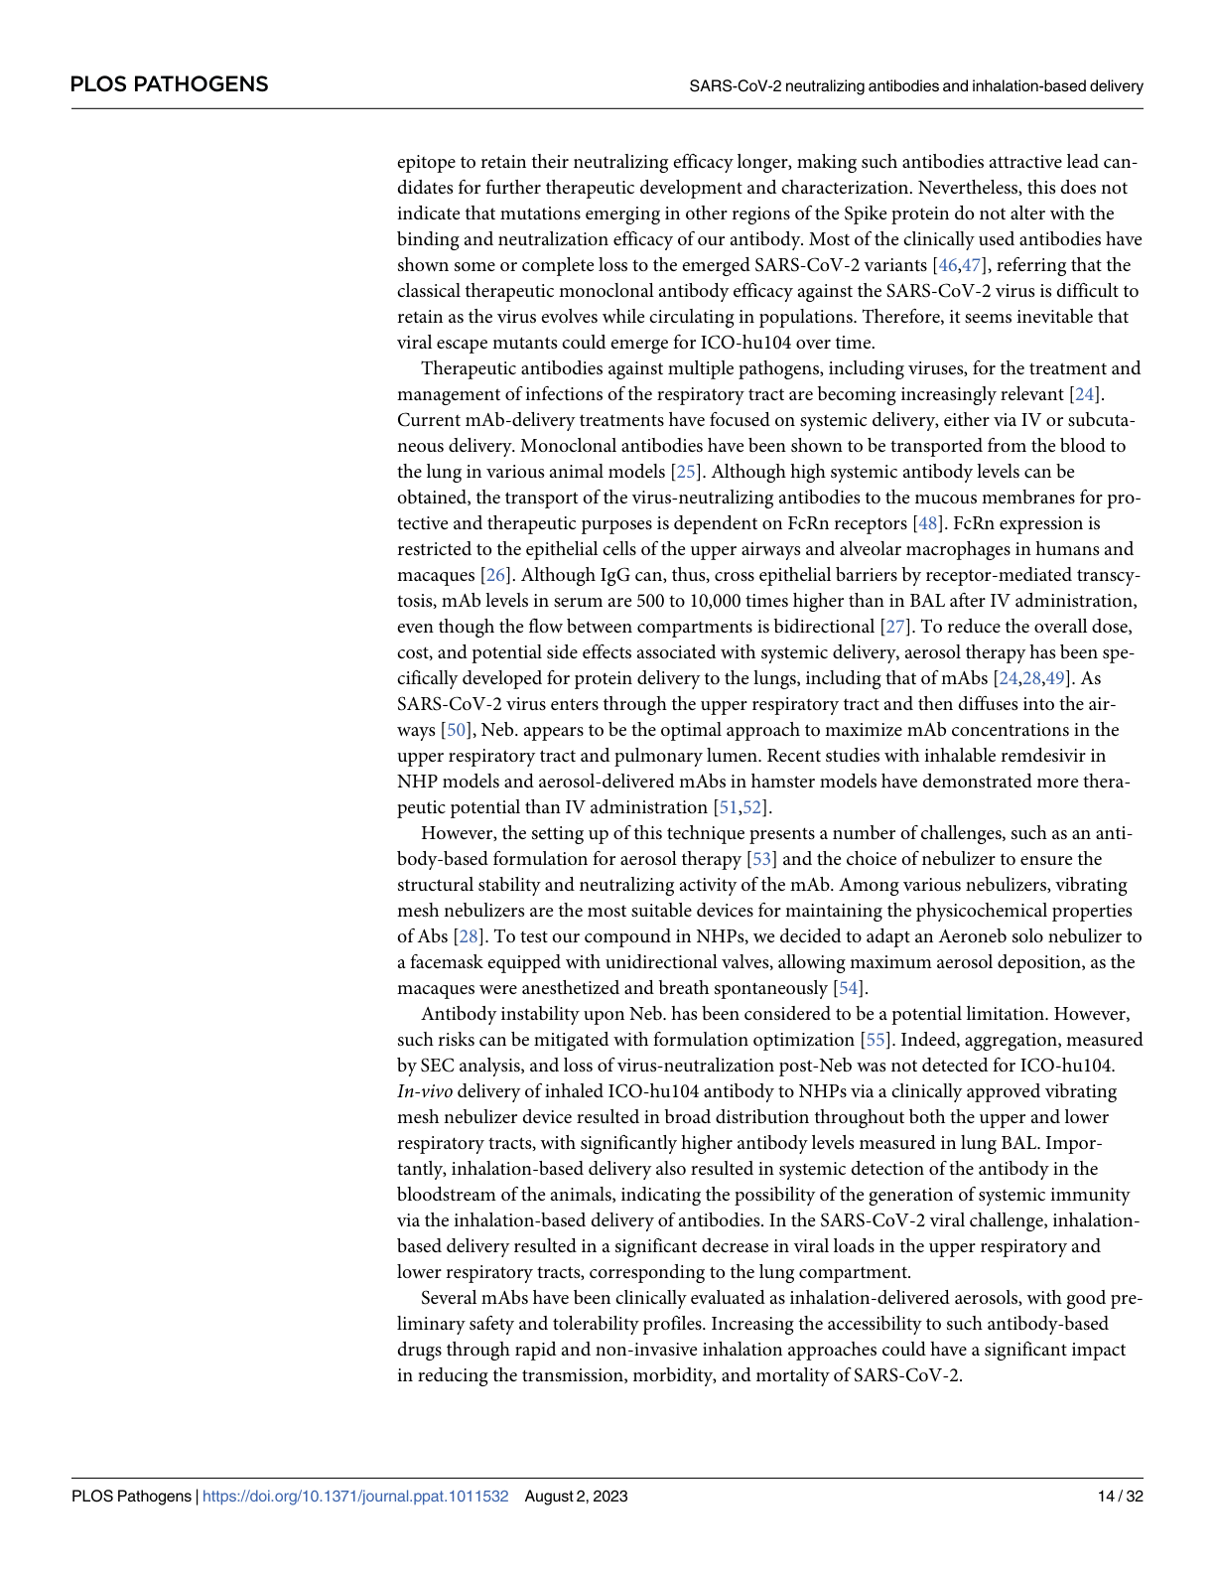
Impact on Viral Load
Inhaled antibody significantly reduced viral load
Rapid activity at primary infection sites
Improved therapeutic efficiency compared with systemic exposure
Promising platform for respiratory virus treatment

Slide 9
Clinical and Commercial Relevance
Inhaled biologics may simplify outpatient treatment
Potentially scalable for future respiratory outbreaks
Supports development of variant‑resistant antibody therapies
Demonstrates innovative delivery strategy from Icosagen collaboration

Slide 10
Conclusion
Broadly neutralizing inhaled antibodies represent a promising direction for accessible and effective respiratory antiviral therapy.

